Slide 1
Stakeholders
Bench chemists performing procedures
Direct users of hazardous chemicals
Neighbors of hazardous processes
Lab supervisors with direct legal responsibility
Lab group leaders
Core facility managers
Institutional and public bodies that support laboratory science
Facility designers and operators
Safety service providers, including emergency planning and response and waste disposal staff, usually associated with EHS departments and regulators
OSP Liaisons with community and granting agency
The larger scientific community
Use of Lessons Learned
Public confidence to support funding of lab sciences
Notes:
Would like to anticipate the threats and consequences for exposure to the hazards of a given substance or group of substances and relate these to different control options
Goal is successful experiment and minimization of exposure
Exposure happens with loss of control leading to an adverse outcome
Exposure potential = inherent hazard X local risk (likelihood)
Minimize exposure by mitigating threats and consequences
Mitigate threats by monitoring and controlling conditions

Slide 2
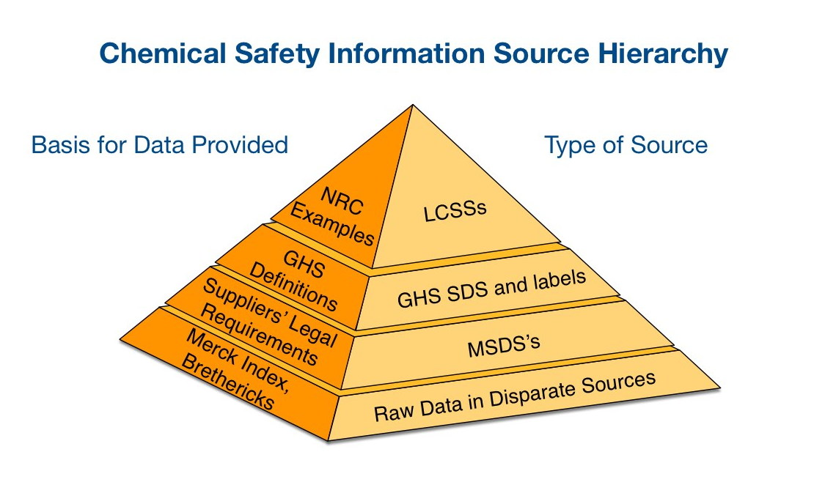
The Evolution of Chemical Safety Information
Increasingly user-specific and well-defined; also increasing voluminous
1990's
2000's
1980's
1970's
GHS might serve as a periodic table style ontology by organizing recognized chemical hazards into coherent groups, but needs to be connected to the existing chemical safety corpus to realize this oppotunity

